Slide 1
Jordan Wesson
Cross-Platform Development
Oiram
Technical Design Document

Slide 2
Project Summary
A linear 3D Mario inspired platformer with a focus on the jump mechanic. The player has a triple jump combo gaining speed and height with each stage of the jump. The jump is inspired by Mario’s triple jump from Mario 64. The aim of the game is to complete each level under the time limit with the option of collecting coins.

Slide 3
Target Audience
The game is intended for young children but can be enjoyed by adults and can become a challenge for speed runners.
G

Slide 4
Game Controls (PC)
WASD is used to move
The mouse is used to look around.
Space is used to jump

Slide 5
Game Controls (Touch)
The left virtual joystick is used to move
The right virtual joystick is used to look around
The button labelled Jump is used to jump.

Slide 6
Game Controls (Controller)
Left joystick is used to move
Y or Triangle button is used to jump

Slide 7
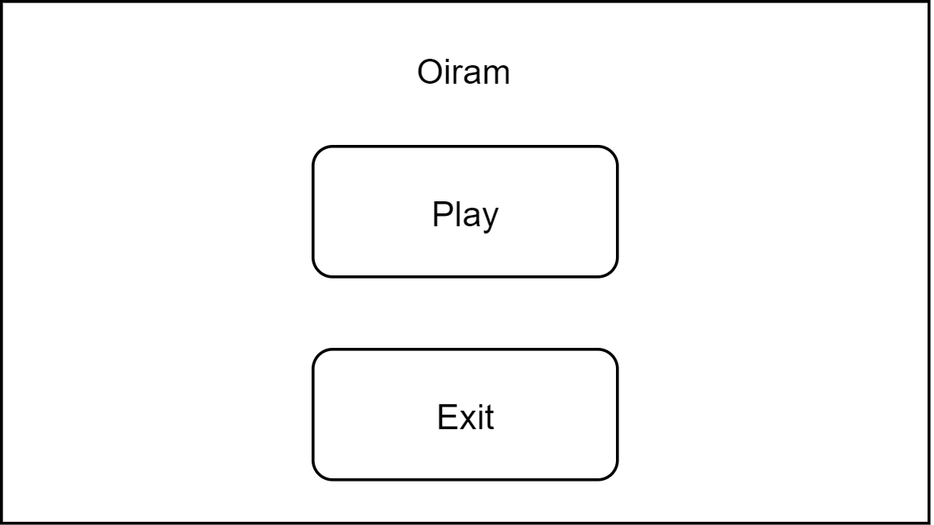
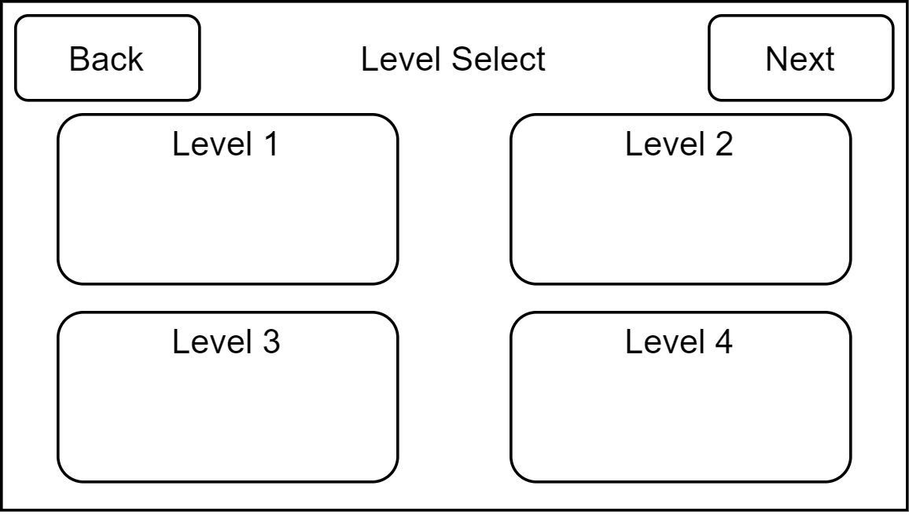
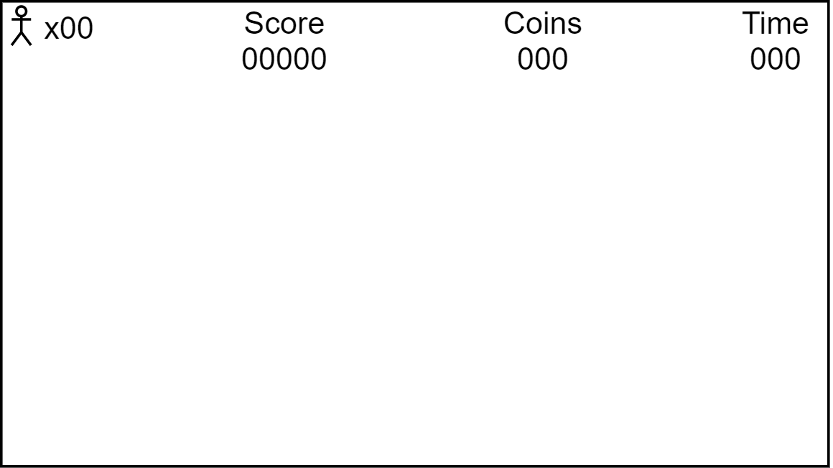
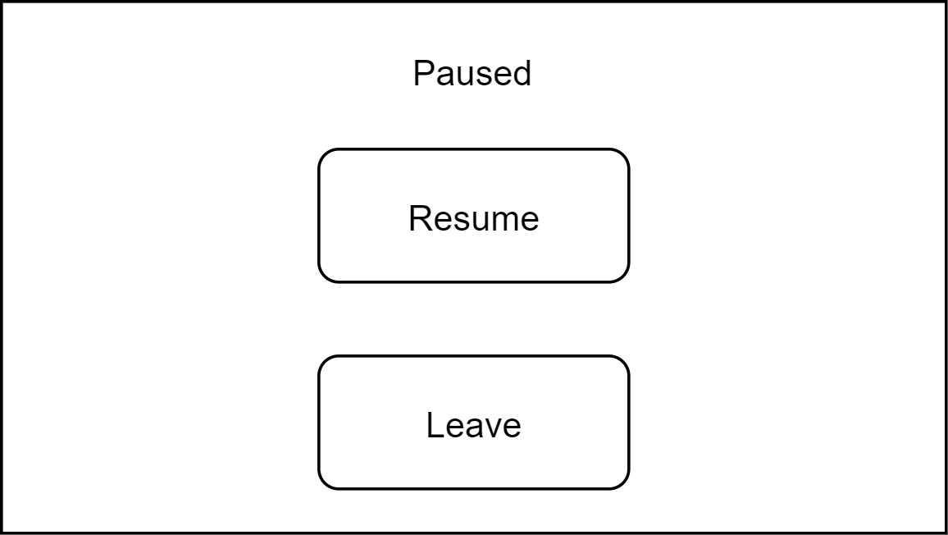
GUI Wireframe

Slide 8
Assets
Player Character - https://assetstore.unity.com/packages/3d/characters/humanoids/humans/3d-character-dummy-178395
Player Animations (not currently used) - https://assetstore.unity.com/packages/3d/animations/basic-motions-free-154271
Footstep and Landing sounds - https://opengameart.org/content/foot-walking-step-sounds-on-stone-water-snow-wood-and-dirt
Menu Theme - https://opengameart.org/content/overworld-theme
Coins - https://opengameart.org/content/coin-sounds-0
World Platform Blocks - Me

Slide 9
Software and Tools Used
Software:
Unity
Visual Studio
Tools:
Google
YouTube

Slide 10
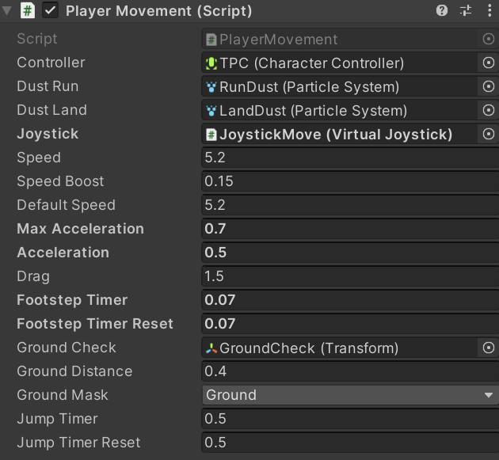
Implemented System
Player Movement:
The players movement utilises a physics system to move and slow down as well as control the jump, the player can also near instantly change their direction when mid air.
Controller – Link to the players movement controls
Dust Run – Link to the run particle effect
Dust Land – Link to the land particle effect
Speed – Speed at which the player moves
Speed Boost – Additional speed when the player jumps
Default Speed – Base speed to be reverted to after jumps
Max Acceleration – The max speed at which the player can accelerate
Acceleration – Speed at which the player accelerates each second
Drag – Speed at which player slows down
Footstep Timer – Time between footstep sounds
Footstep Timer Reset – Base time to be reverted to after Footstep Timer gets to or below 0
Ground Check – Empty object that checks weather or not its in the ground or not
Ground Distance – Radius that the Ground Check checks
Ground Mask – Used to determine what is and isn’t ground
Jump Timer - Time the player has after hitting ground before jumps reset
Jump Timer Reset – Base time to be reverted to after Jump Timer gets to

Slide 11
Implemented System
Jump Mechanic:
The players jump has 3 stages, each stage of the jump the player jumps higher and gains a slight speed boost.
The player starts on the first jump, when they land on the ground, they roughly a second to jump again to go into the second jump and same with the third jump.
If the jump timer gets to zero or they finish the third jump, they go back to the first jump.
Configuration for jump is is the list with player movement.

Slide 12
Implemented System
Buttons:
In the Menu there’s a Play and a Exit button, the Play takes the player to the Level Select, and the Exit leaves the game.
The Level Select has a Back button which takes the player back to the Menu, and Level buttons that take the player to the designated level.
In the Pause menu there is a Return button that takes the player back to the game and a Leave button the takes the player back to the Menu.

Slide 13
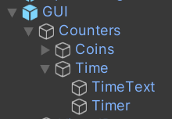
Implemented System
Timer and Coins:
Timer:
The timer starts at a set time on the start of the level and counts down to 000.
The timer always has 3 digits with 0’s at the front in place of any unused digit.
When the timer reaches 000, the player fails the level and has to restart.
Coins:
The coins are placed along the optimal path for the player to take when jumping across gaps or up ledges.
When the player collides with the coins, they disappear and the coins counter goes up 1.
Similar to the timer, the coin counter has a single 0 in front when not all digits are being used.

Slide 14
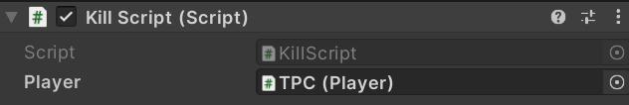
Implemented System
Bottom of the world death barrier:
The death barrier sits below the map and resets the level when collided with indicating the player failed.
Level End:
On collision with the door of the level end, it takes the player to the next level, or if there isn’t an available next level it takes the player to the menu.
Player – Link to the player

Slide 15
Implemented Systems
Audio Manager:
List of sounds triggered by specific player actions.
Input Manager:
Tool to easily switch between different control schemes.

Slide 16
Implemented Systems
Cursor Modes:
Used to change the cursor lock mode depending on what input type is selected.
Level Start:
Make sure player spawns in expected position on start of level.

Slide 17
Software / System Requirements
Spec | Desktop | Android | Web
Operating System | Windows 7+ | 4.4+ | -
Graphics API | DX10+ | OpenGL ES 2.0+, Vulkan | -
CPU | x64, x86 | ARMv7 with Neon Support (32-bit) or ARM64 | -

